Slide 1




University Student Registration & Results Management Database
Presentation By
Group 7

Slide 2





Agenda
-SQL — Relationships(ER Digram).
-SQL — Database Design.
-Project Overview.
-Orange — Workflow.
-Power BI Dashboard.
-Python EDA

Slide 3

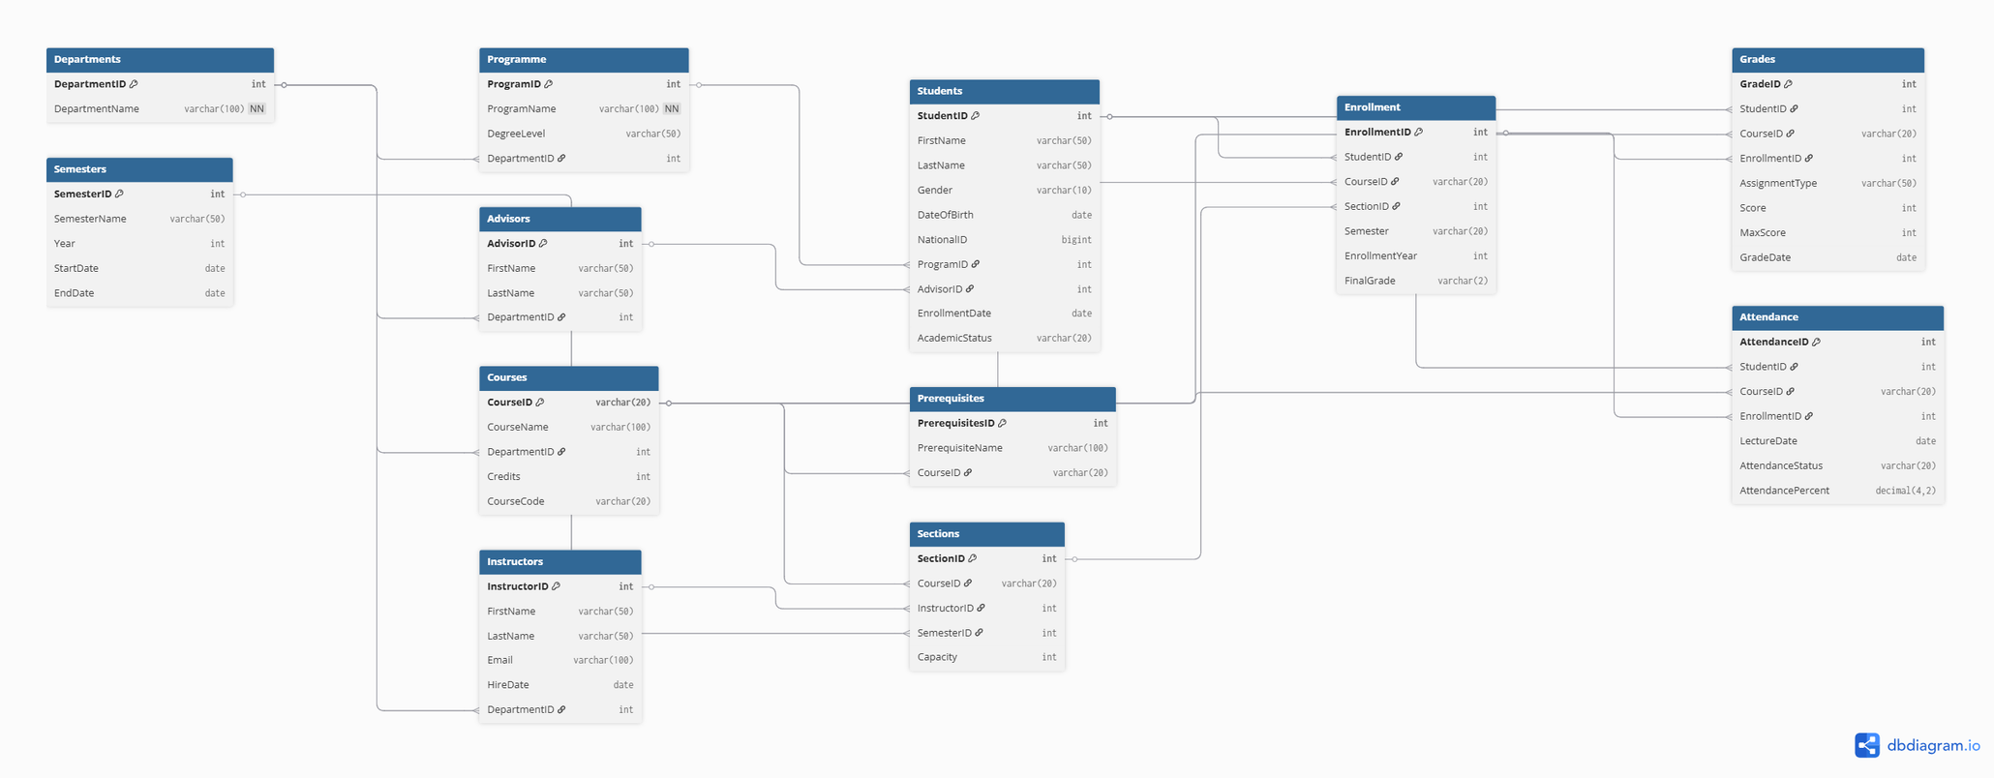

SQL — Relationships(ER Digram).
This diagram represents a fully normalized university database built on 12 relational tables covering all aspects of academic operations — from registering departments, programs, instructors, and advisors, to enrolling students in courses and sections via the Enrollment table, through to recording grades and attendance for each student per course. All tables are linked through foreign keys to ensure referential integrity, with a dedicated Prerequisites table to enforce course requirements and a Semesters table to organize academic terms.
Key Highlights
12 tables linked via foreign keys — fully relational structure
Students is the core entity — connected to Programme and Advisors
Enrollment bridges Students, Courses, Sections, and Semesters
Grades and Attendance are tied directly to each enrollment record
Prerequisites enforces course eligibility rules before registration

Slide 4
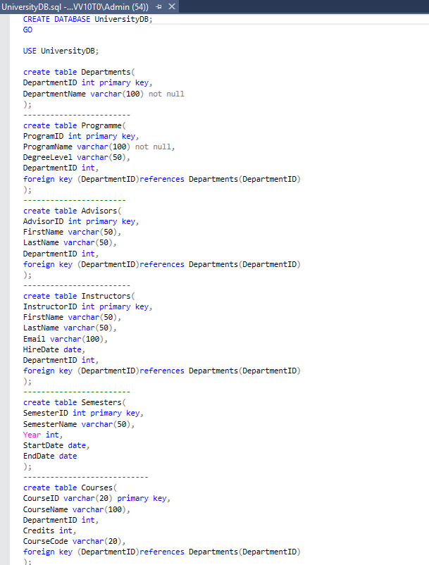
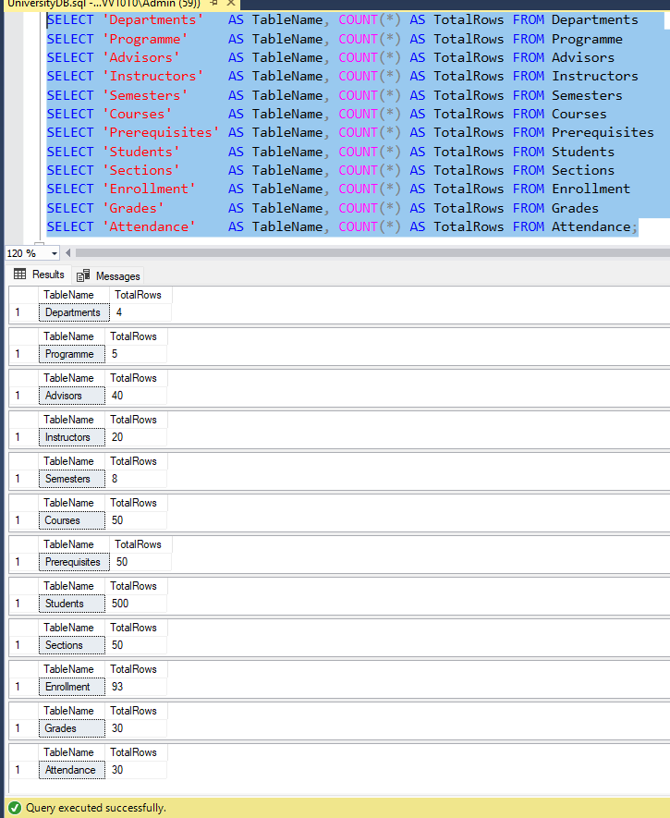
-SQL — Database Design.
This code represents the first part of creating the UniversityDB database tables.

Slide 5
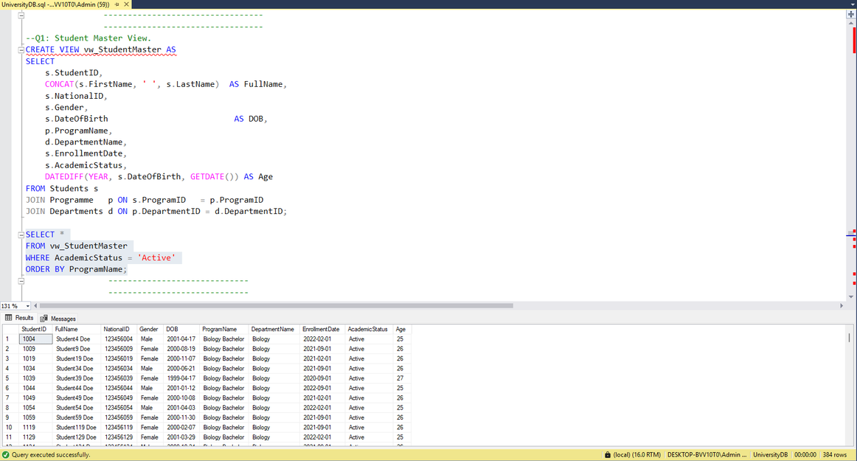
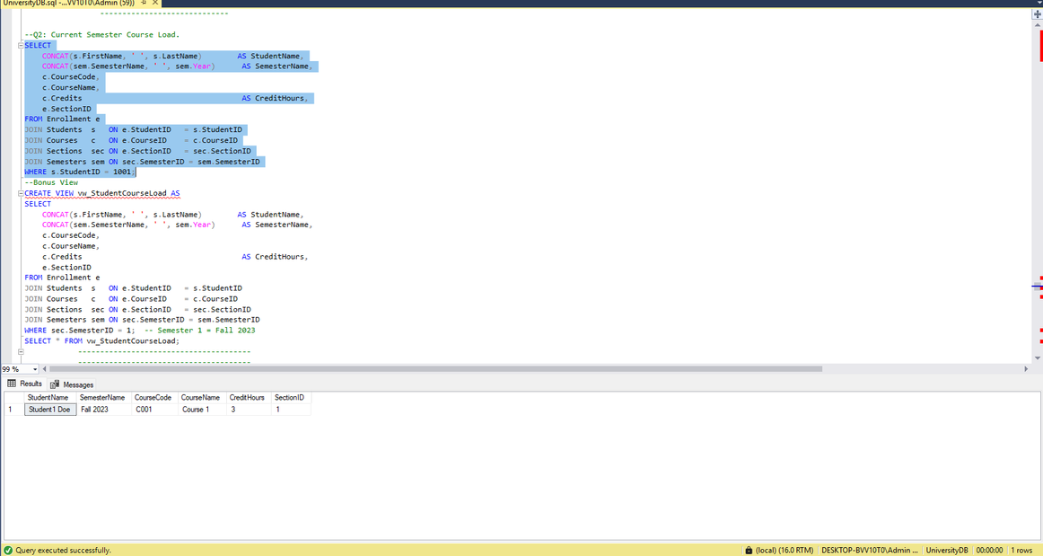
Project Overview
10 key questions with answers
Q1 — Student Master View Creates a comprehensive view joining student data across multiple tables. Output: A table showing StudentName, NationalID, Gender, Program, Department, EnrollmentDate, AcademicStatus, and calculated Age — filtered for Active students ordered by Program.
Q2 — Current Semester Course Load Displays all courses a specific student is registered in for a given semester. Output: A table showing StudentName, SemesterName, CourseCode, CourseName, CreditHours, and SectionID for a filtered Student and Semester.

Slide 6
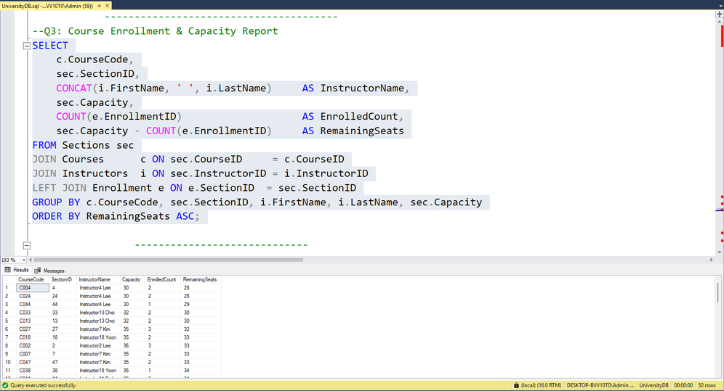
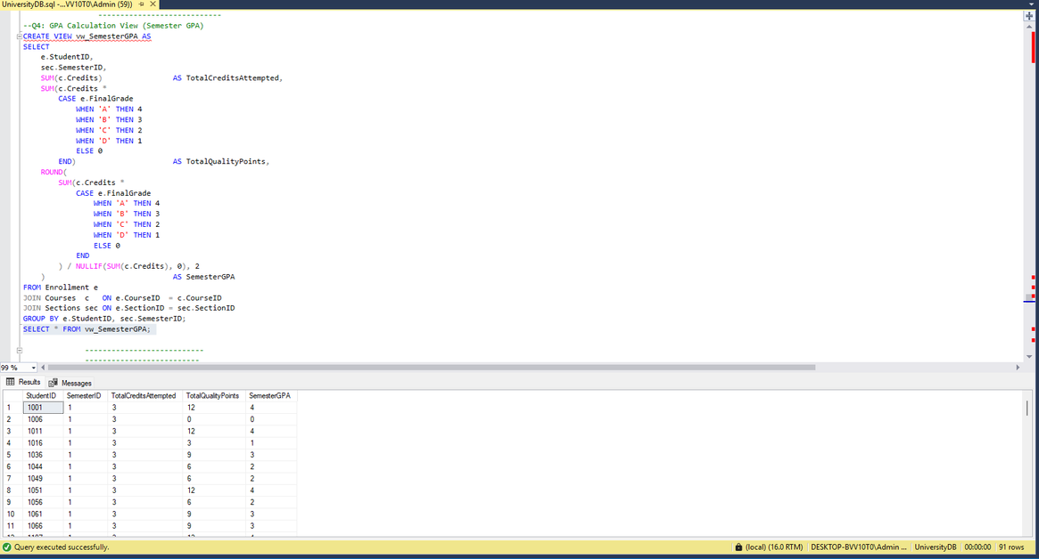
Project Overview
10 key questions with answers
Q3 — Course Enrollment & Capacity Report Reveals how full each section is in a given semester compared to its capacity. Output: A table showing CourseCode, SectionID, InstructorName, Capacity, EnrolledCount, and RemainingSeats — ordered ascending by available seats.
Q4 — GPA Calculation View (Semester GPA) Calculates each student's GPA for a specific semester based on grades and credit hours. Output: A view showing StudentID, SemesterID, TotalCreditsAttempted, TotalQualityPoints, and SemesterGPA — using the grade scale A=4, B=3, C=2, D=1, F=0.

Slide 7
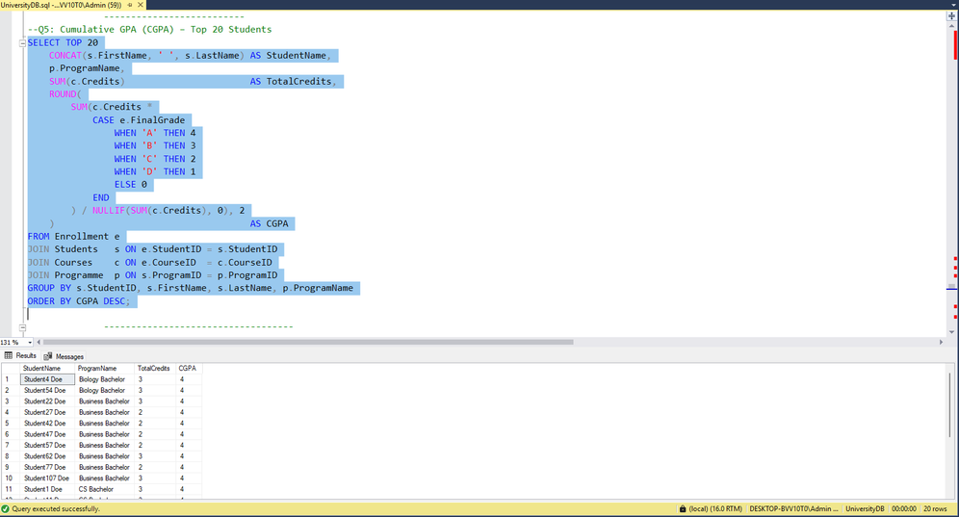
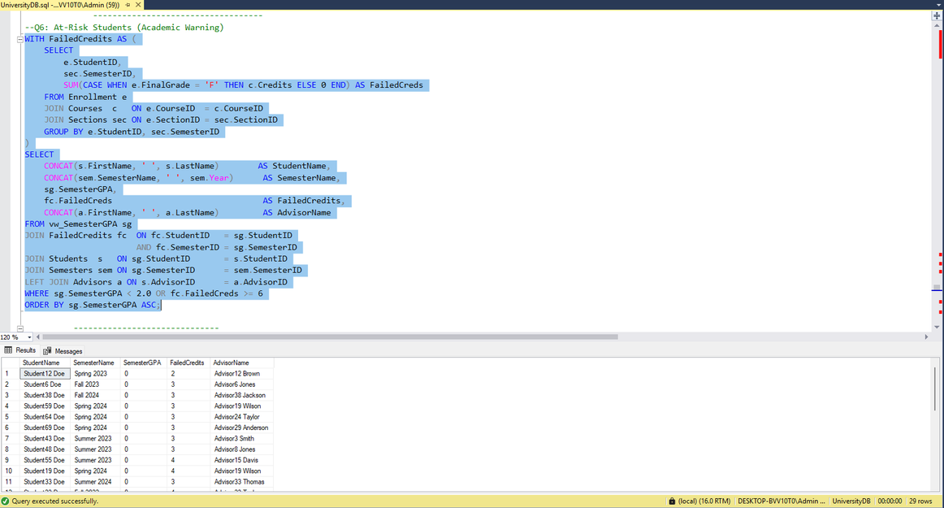
Project Overview
10 key questions with answers
Q5 — Cumulative GPA (CGPA) Computes the overall CGPA per student across all completed semesters. Output: Top 20 students ranked by CGPA (descending), showing StudentName, ProgramName, TotalCredits, and CGPA.
Q6 — At-Risk Students (Academic Warning) Flags students at academic risk based on low semester GPA or high failed credits. Output: A warning list showing StudentName, SemesterName, SemesterGPA, FailedCredits, and AdvisorName — for students with GPA < 2.0 or failed credits ≥ 6.

Slide 8
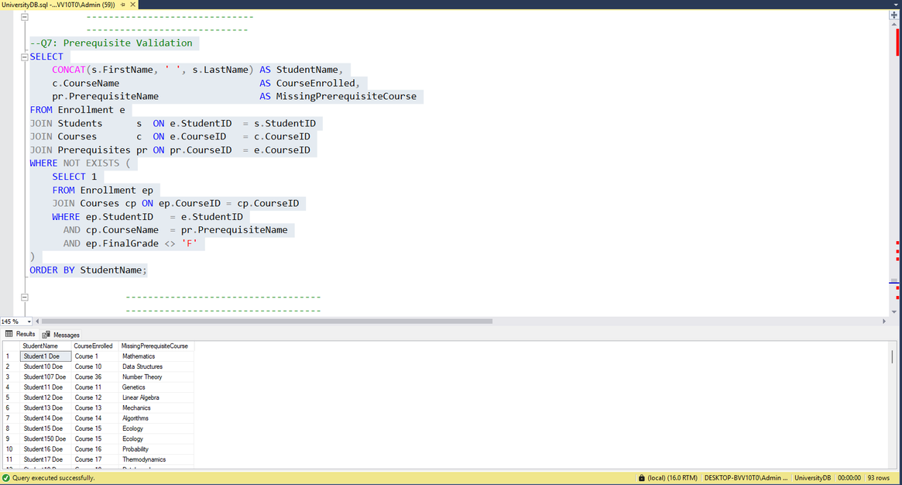
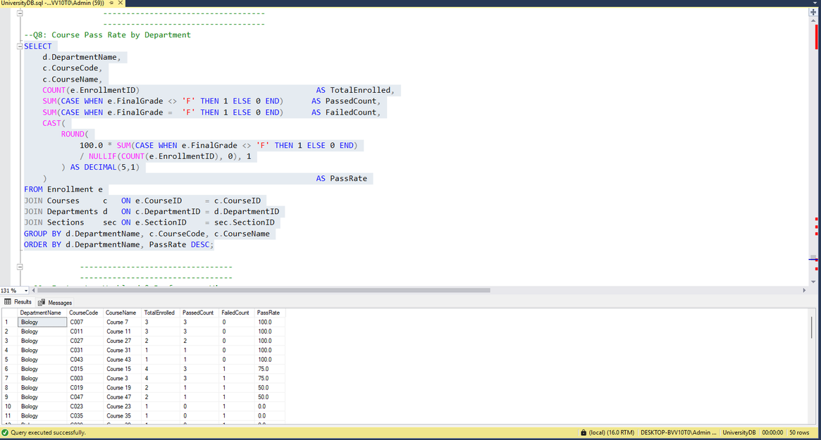
Project Overview
10 key questions with answers
Q7 — Prerequisite Validation Detects invalid enrollments where students registered for a course without passing its prerequisite. Output: A table showing StudentName, CourseEnrolled, and the MissingPrerequisite course(s) — to flag and correct registration errors.
Q8 — Course Pass Rate by Department Calculates the pass/fail rate per course or department for a given semester. Output: A table showing DepartmentName, CourseCode, CourseName, TotalEnrolled, PassedCount, FailedCount, and PassRate% — to identify underperforming courses.

Slide 9
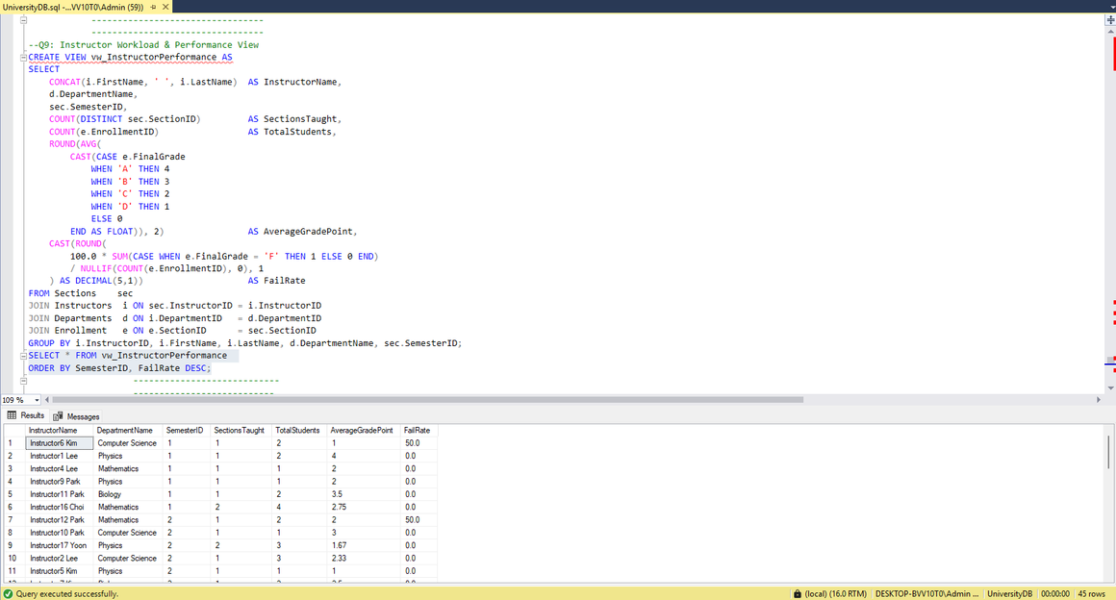
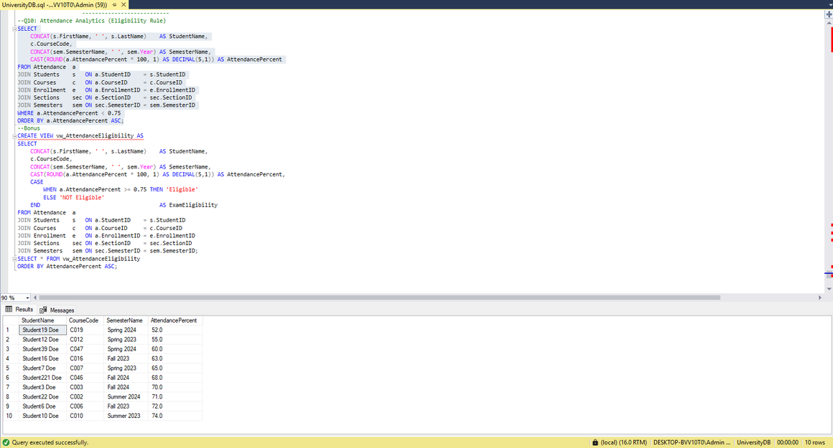
Project Overview
10 key questions with answers
Q9 — Instructor Workload & Performance View Evaluates each instructor's teaching load and student performance per semester. Output: A view showing InstructorName, Department, SectionsTaught, TotalStudents, AverageGradePoint, and FailRate% — to assess teaching quality and workload balance.
Q10 — Attendance Analytics (Eligibility Rule) Identifies students ineligible for the final exam due to low attendance. Output: A list showing StudentName, CourseCode, SemesterName, and AttendancePercent — for all students below the 75% attendance threshold.

Slide 10
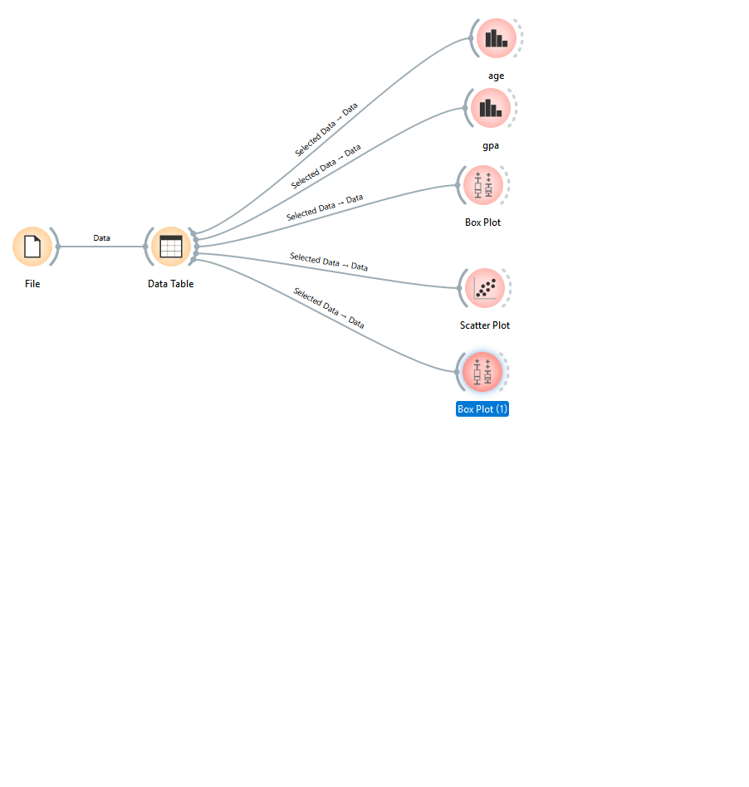
-Orange — Workflow.
This diagram shows an Orange Data Mining Workflow that loads data from a single File into a Data Table, which then feeds 5 visual analyses — all without writing any code:
Age distribution chart
GPA distribution chart
Box Plot for comparison
Scatter Plot to explore relationships
Box Plot (1) for additional comparison
Each analysis receives "Selected Data → Data" from the central Data Table, enabling interactive visual exploration of the dataset.

Slide 11
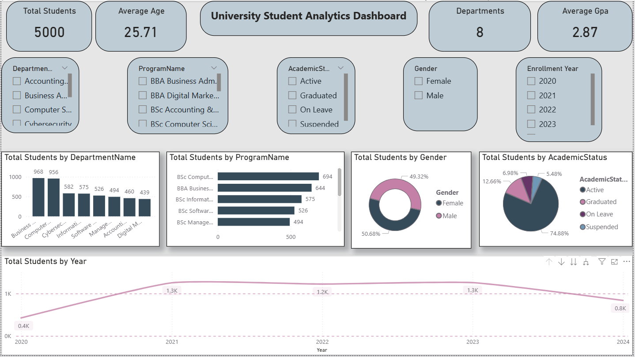
University Student Analytics Dashboard
The dashboard presents data on 5,000 students across 8 departments with an average GPA of 2.87 and an average age of 25.71. Business leads all departments with 968 students, while BSc Computer Science is the most popular program at 694. Gender distribution is nearly equal (50.68% Female / 49.32% Male), with 74.88% of students academically active, while the 5.48% Suspended group requires immediate intervention. Enrollment peaked in 2021 and 2023 at 1.3K but dropped to 0.8K in 2024, signaling a trend that needs investigation.

Slide 12

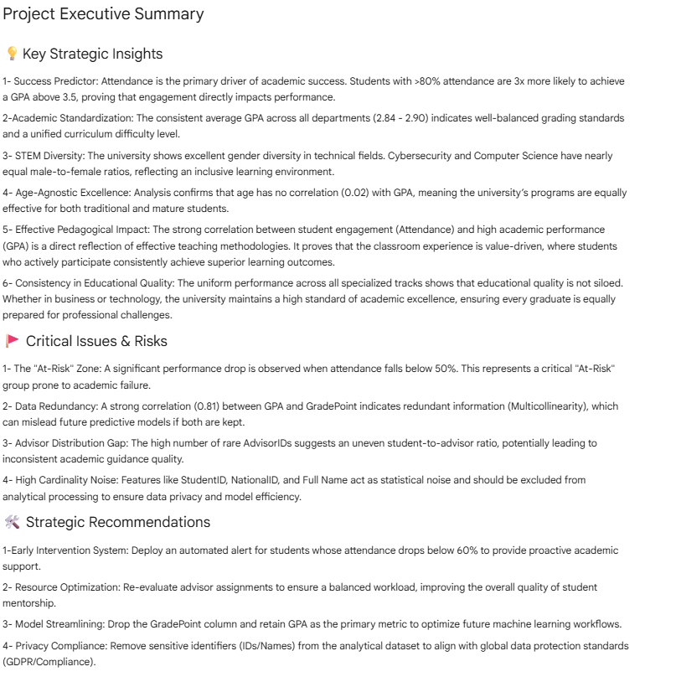

Python EDA
Data for 5,000 students was loaded from an Excel file containing 6 sheets, cleaned with zero missing or duplicate values, and a balanced gender split with an average GPA of 2.87 consistent across all departments. Analysis revealed that attendance is the primary driver of academic success — students above 80% attendance are 3x more likely to achieve a GPA above 3.5 — while age showed no impact. Students below 50% attendance were flagged as a critical at-risk group, and high-cardinality identifiers were excluded for privacy compliance.

Slide 13



Thank You!

